Slide 1
Drones and Rooms
Voronoi, Graph Routing, Drone Animation
UFR STGI — Master IoT 1
Presented by:
Ahmed Almuharaq Boluwatife ABIONA
Super visor: Prof. Benoit Piranda

Slide 2
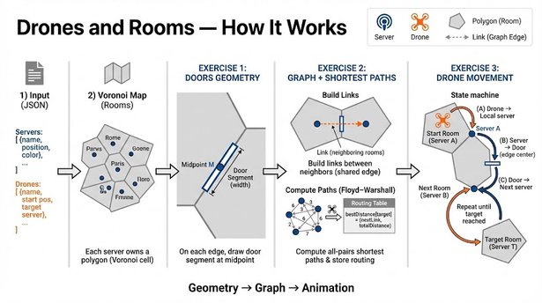
Project Overview

Slide 3
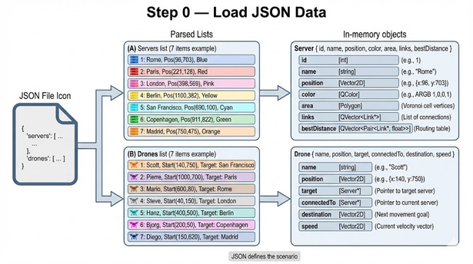
Step 0 — Load JSON Scenario

Slide 4
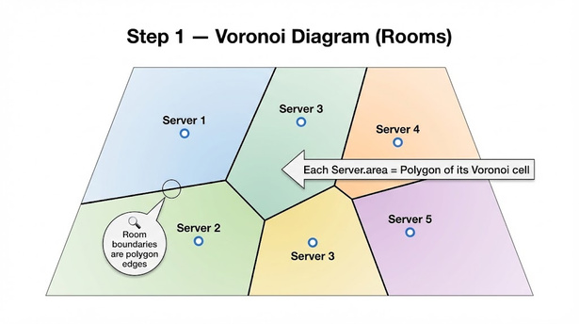
Step 1 — Voronoi Rooms (Polygons)

Slide 5
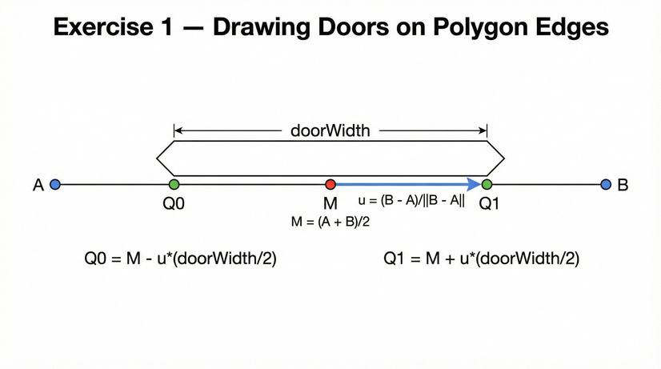
Exercise 1 — Door Geometry

Slide 6
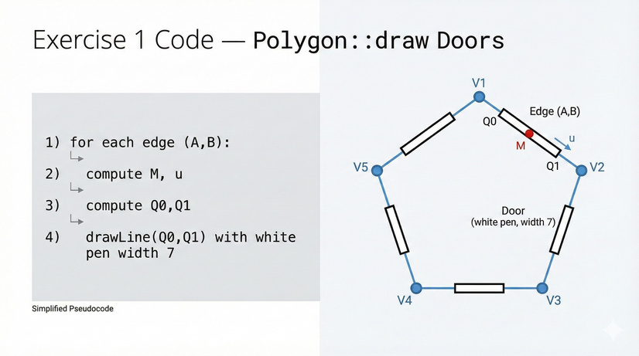
Exercise 1 — Code (Polygon::draw Doors)

Slide 7
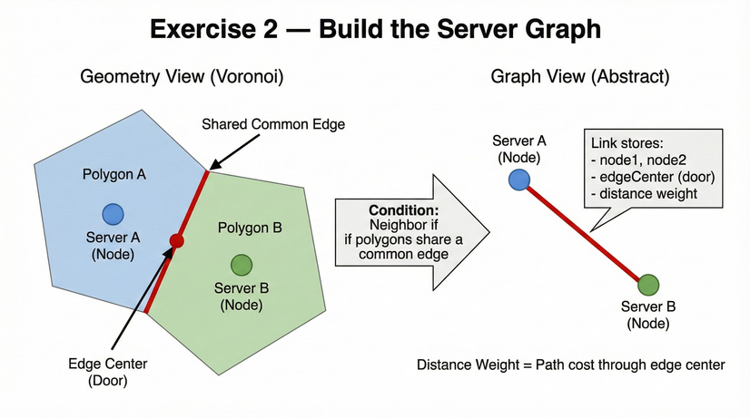
Exercise 2 — Graph Creation (Neighbors)

Slide 8
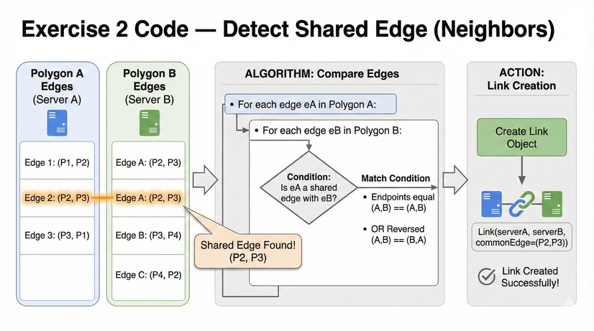
Exercise 2 — Code (Detect Shared Edge)

Slide 9
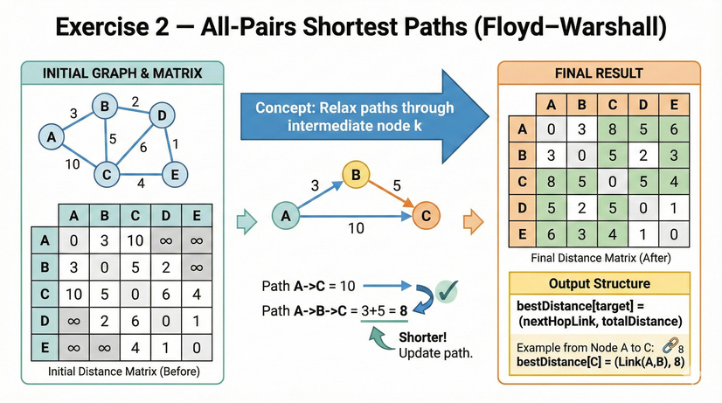
Exercise 2 — Shortest Paths (Floyd–Warshall)

Slide 10
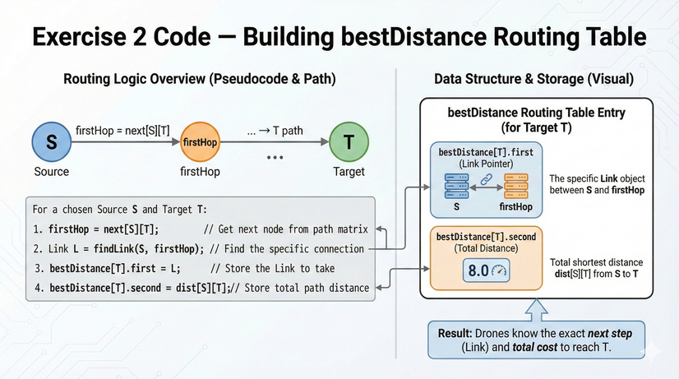
Exercise 2 — Routing Table (bestDistance)

Slide 11
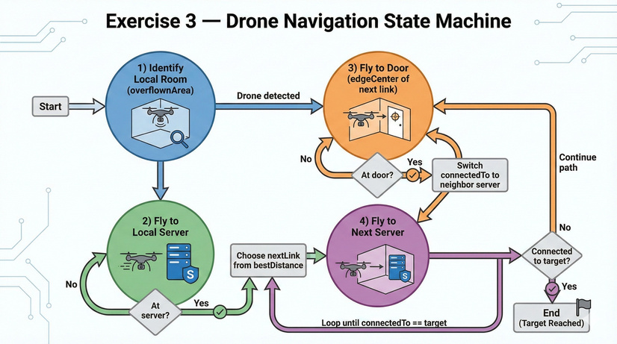
Exercise 3 — Drone State Machine

Slide 12
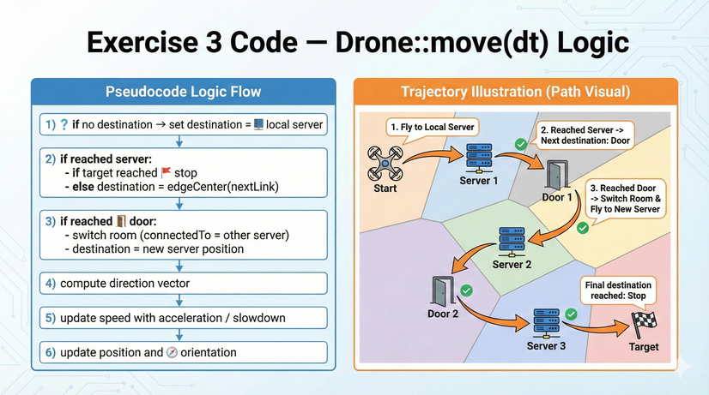
Exercise 3 — Code (Drone::move + dt scaling)

Slide 13
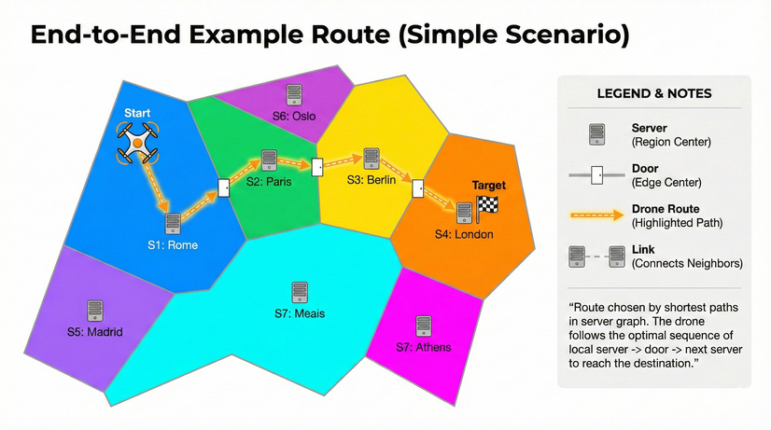
End-to-End Example Route

Slide 14
ThankYou!
Questions?

